Slide 1
CS 207 PROJECT
FIRE EXTINGUSHING SYSTEM
TOMESH TREVOR

Slide 2
CREATED BY
VIRAJ PATEL
PREM PATEL
HARSH PATEL

Slide 3
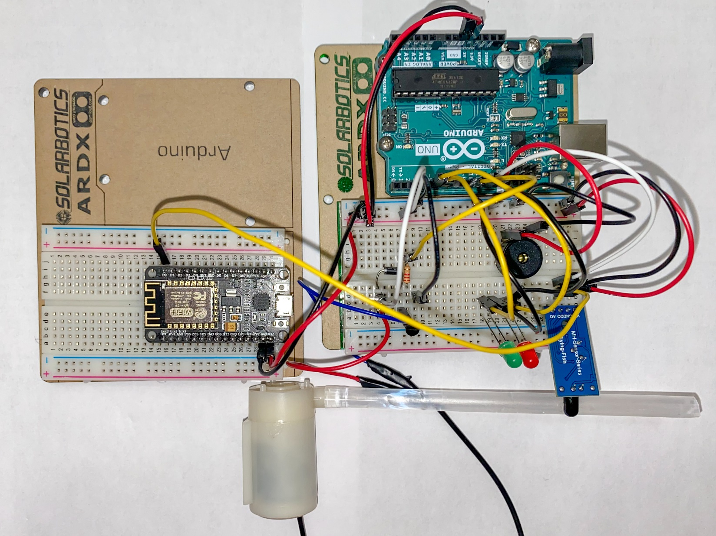
FIRE EXTINGUSHING SYSTEM

Slide 4
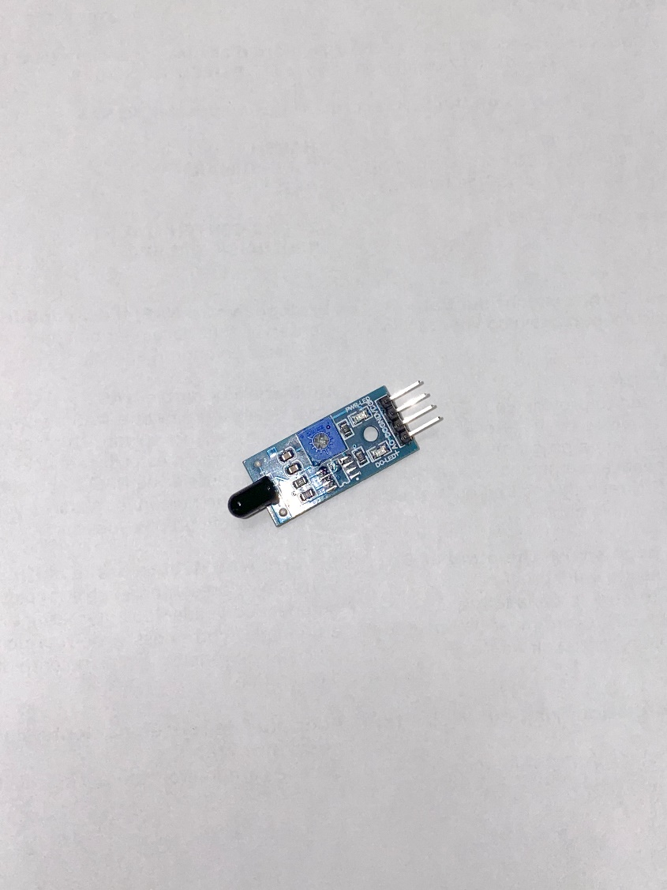
LIST OF MATERIAL REQUIERD TO BUILT THE CIRCUIT
FLAME SENSOR
Flame Sensor is used to detect the flame
Initial reading is 1(high) but when the flame gets
Detected the reading will 0(low).

Slide 5
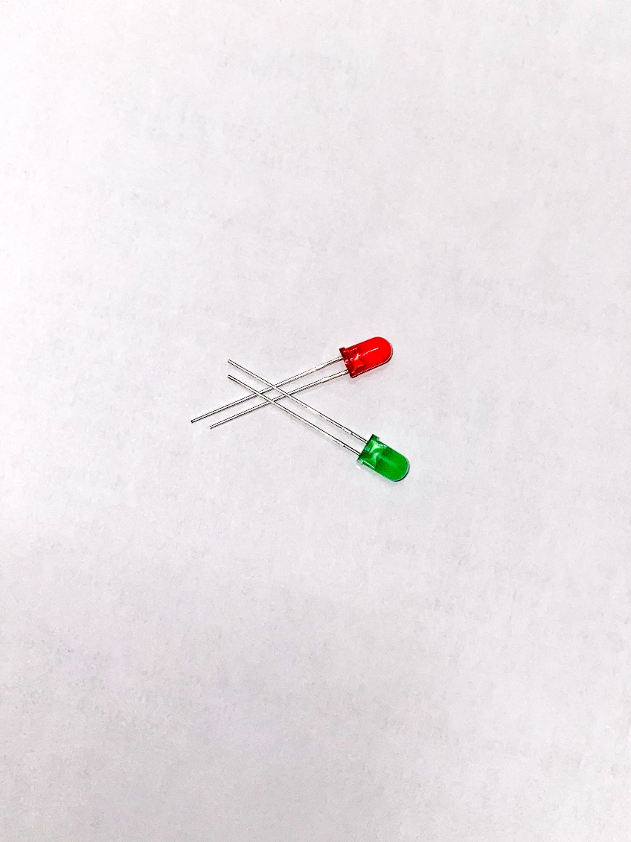
LIST OF MATERIAL REQUIERD TO BUILT THE CIRCUIT
LED
Light Emitting Diode

Slide 6
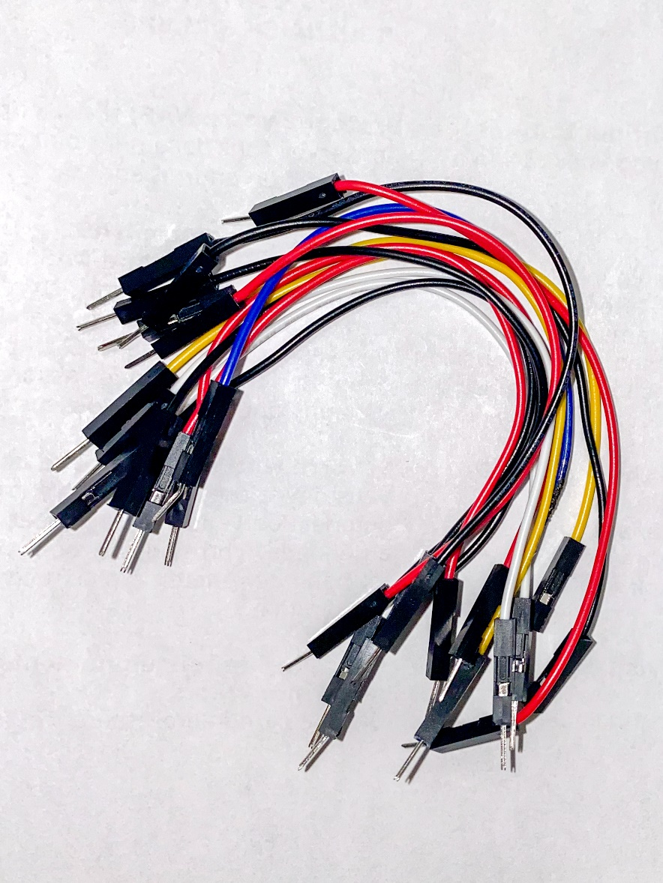
LIST OF MATERIAL REQUIERD TO BUILT THE CIRCUIT
Jumper wires

Slide 7
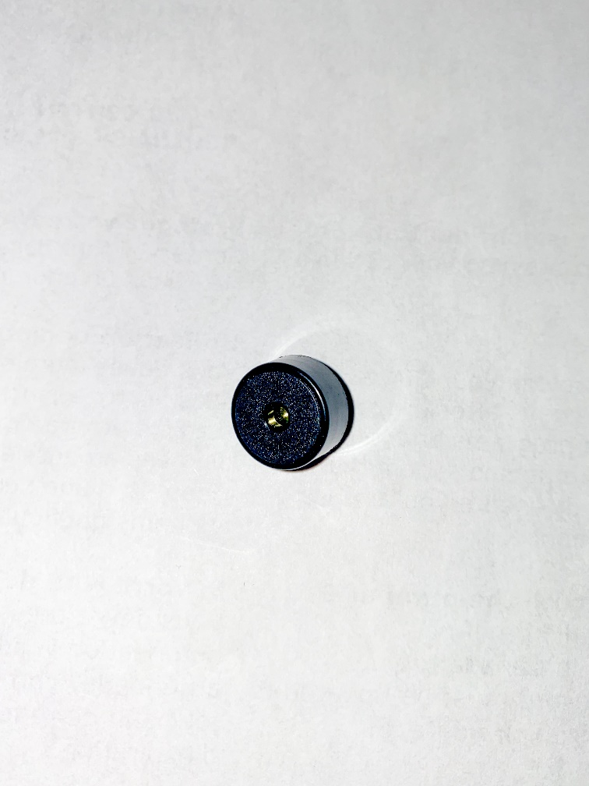
LIST OF MATERIAL REQUIERD TO BUILT THE CIRCUIT
Buzzer
A buzzer or beeper is an audio signalling device
speaker

Slide 8
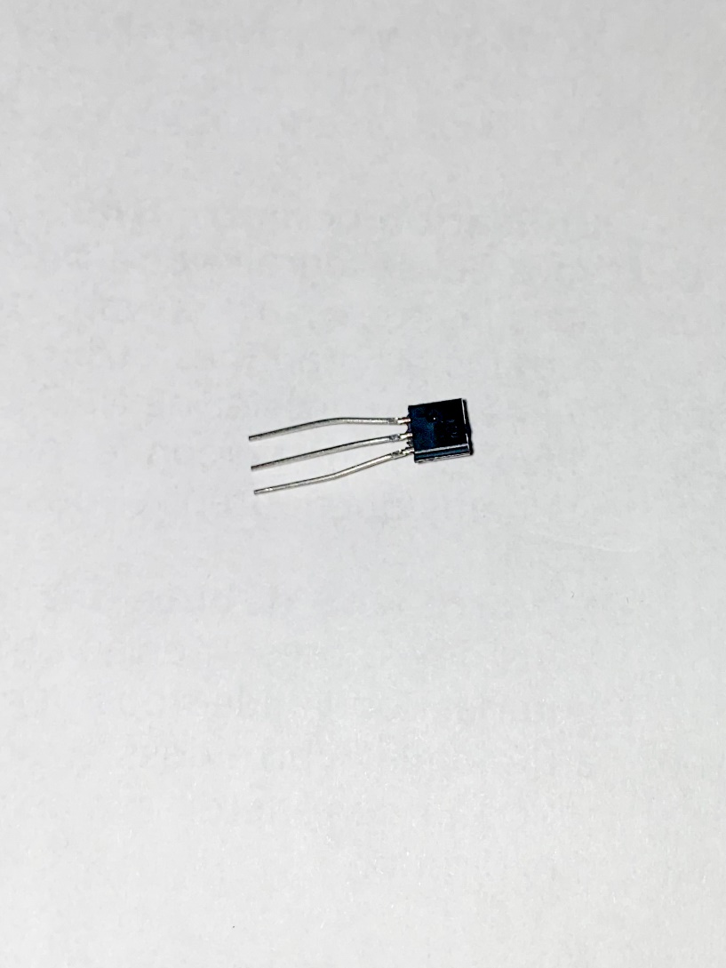
LIST OF MATERIAL REQUIERD TO BUILT THE CIRCUIT
Transister
A transistor is a semiconductor device used to amplify or switch electronic signals and electrical power.

Slide 9
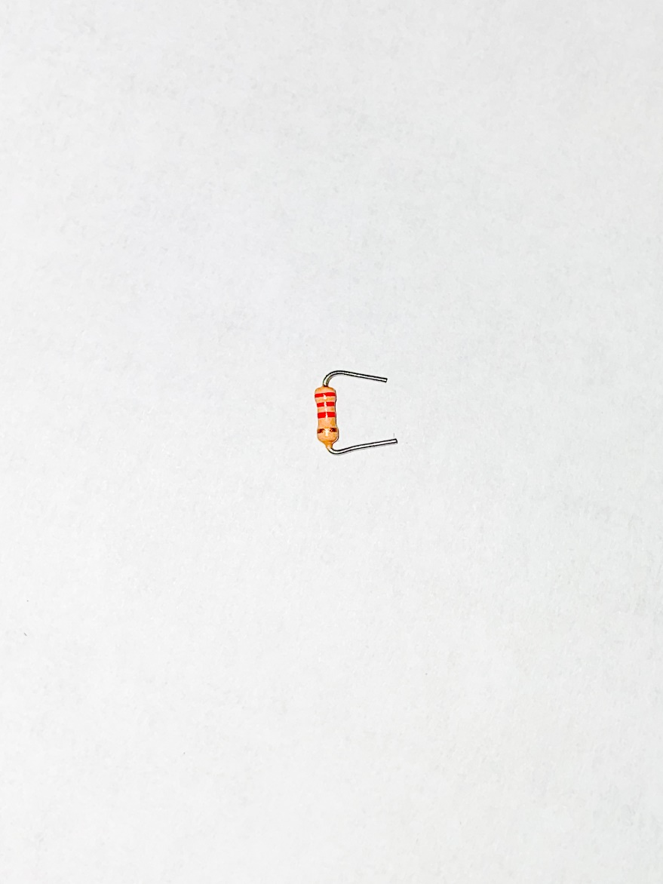
LIST OF MATERIAL REQUIERD TO BUILT THE CIRCUIT
Register
Register is used to resist the flow of current

Slide 10
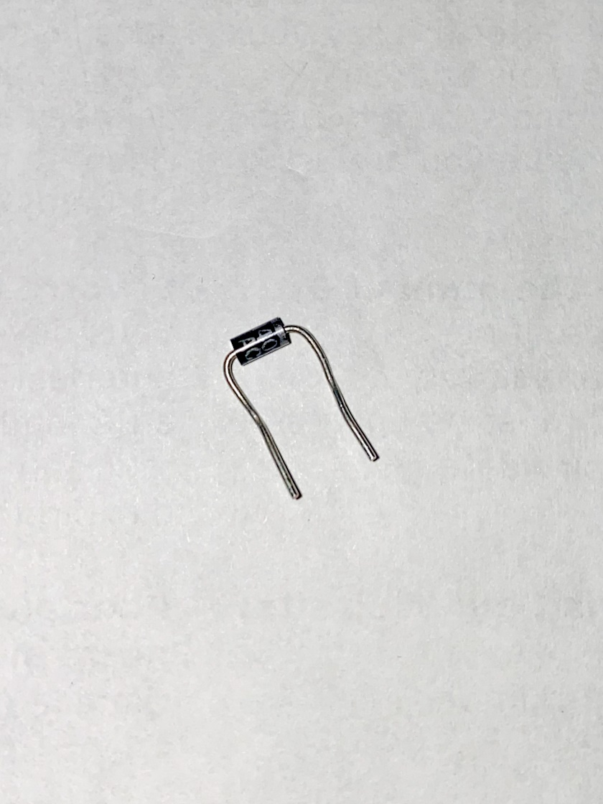
LIST OF MATERIAL REQUIERD TO BUILT THE CIRCUIT
Diode
The function of a diode is to allow an
electric current to pass in one direction

Slide 11
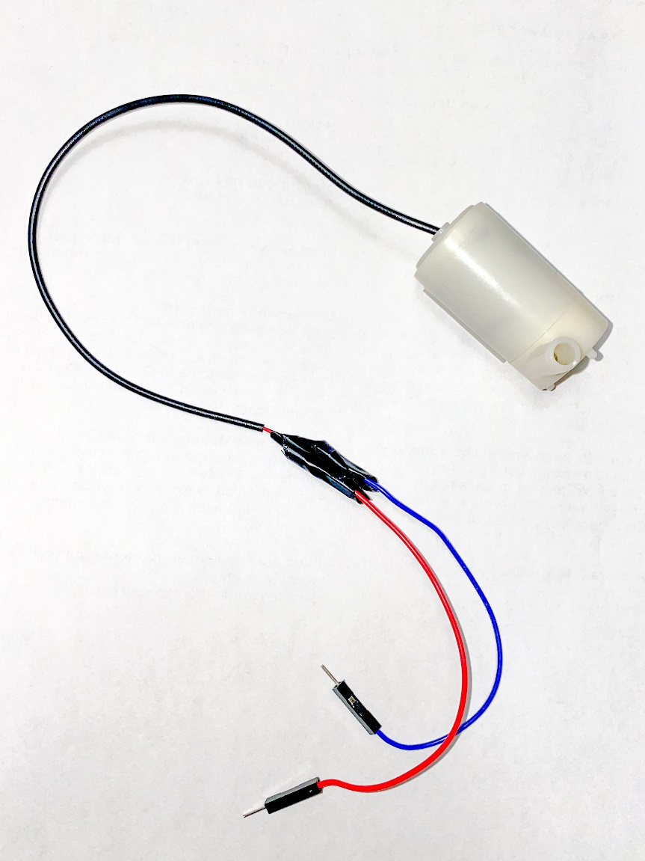
LIST OF MATERIAL REQUIERD TO BUILT THE CIRCUIT
Mini submersible pump
Mini water pump 3 to 5 volts

Slide 12
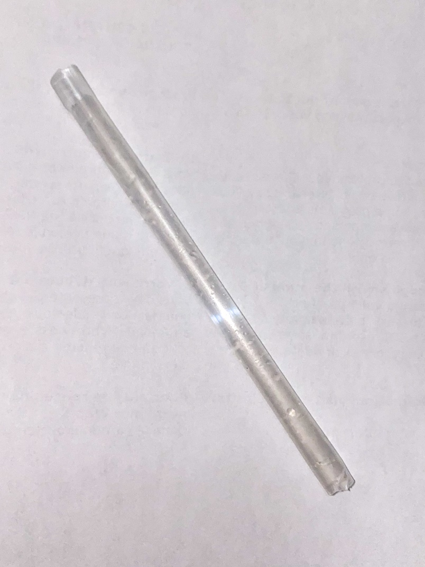
LIST OF MATERIAL REQUIERD TO BUILT THE CIRCUIT
Pipe to connect pump

Slide 13
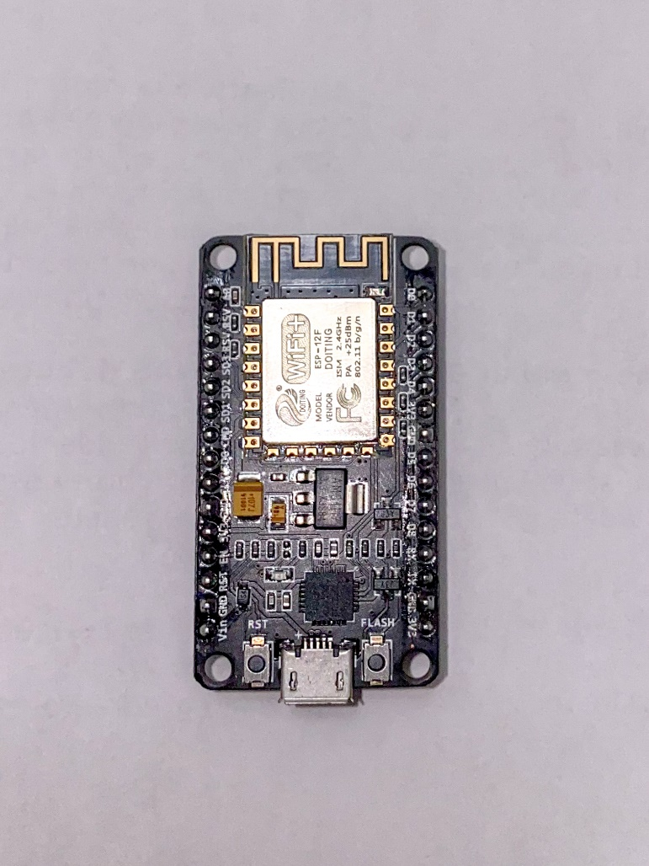
LIST OF MATERIAL REQUIERD TO BUILT THE CIRCUIT
Wi-Fi module ( NodMCU )
The ESP8266 WiFi Module is a self contained SOC with
integrated TCP/IP protocol stack that can give any
microcontroller access to your WiFi network.
Used to send the notification.

Slide 14
Circuit building

Slide 15
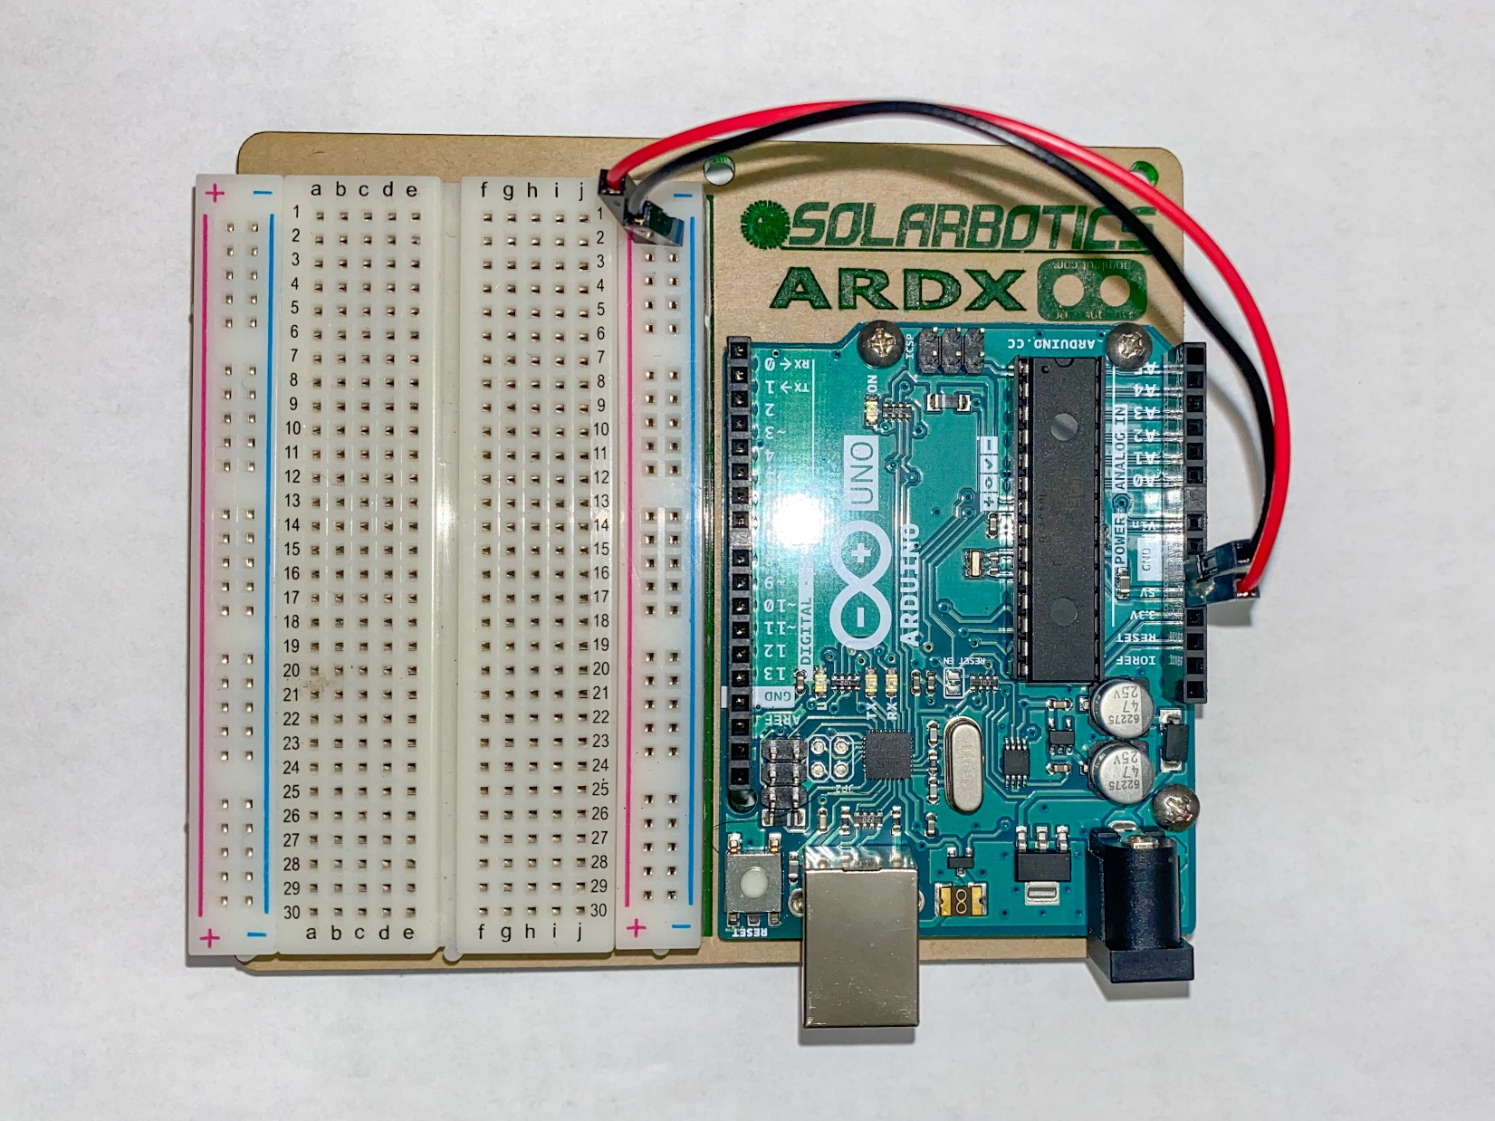
Step 1
Firstly, connect the Arduino with the breadboard
5 volts with (+)
Ground with (-)

Slide 16
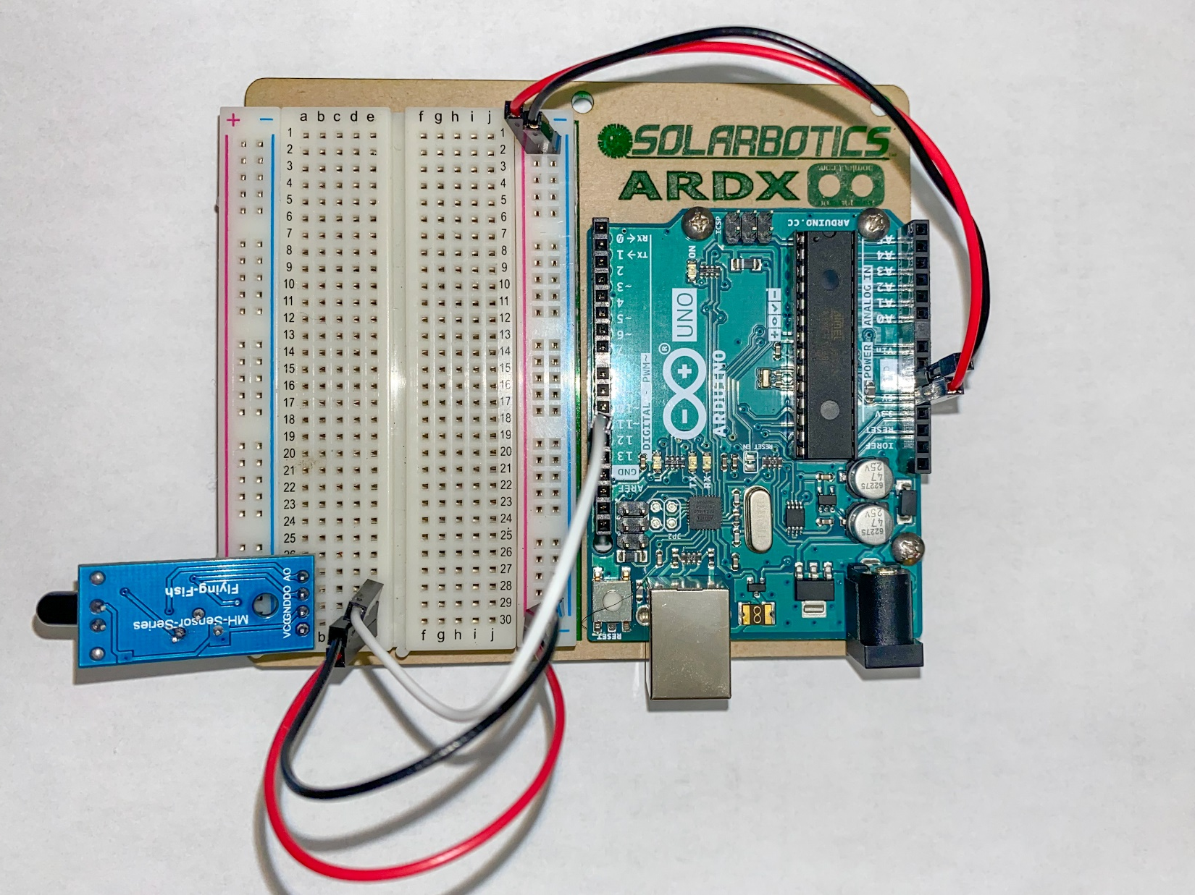
Step 2
Connect the flame sensor
VCC with (+)
GND with (-)
D0 with (pin 11)

Slide 17
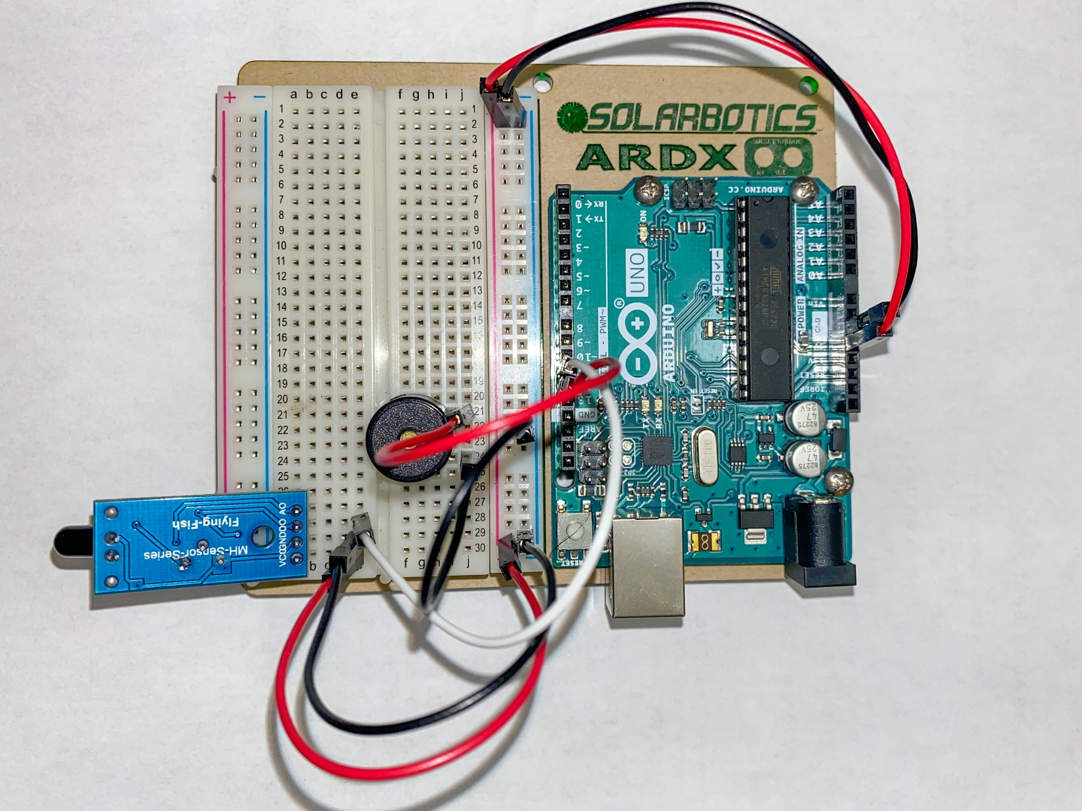
Step 3
Buzzer is connected with the pin 12
Other to ground

Slide 18
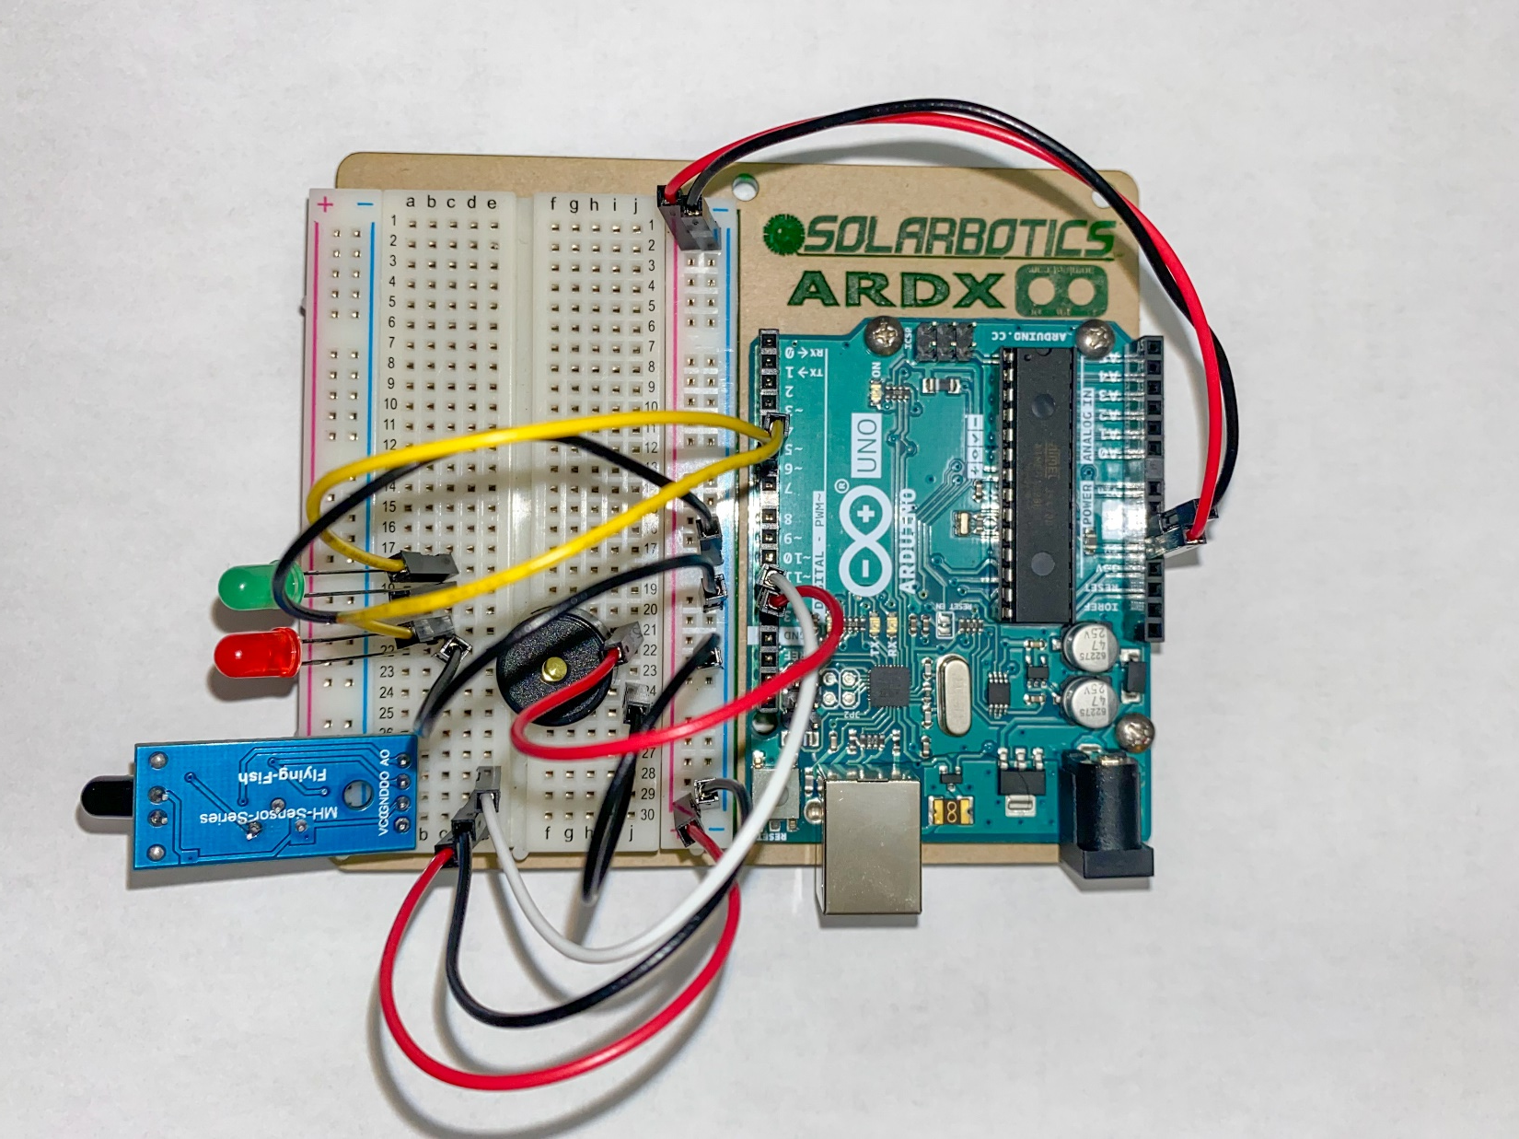
Step 4
Now the green LED are connected to pin 5
And red LED are connected to pin 6

Slide 19
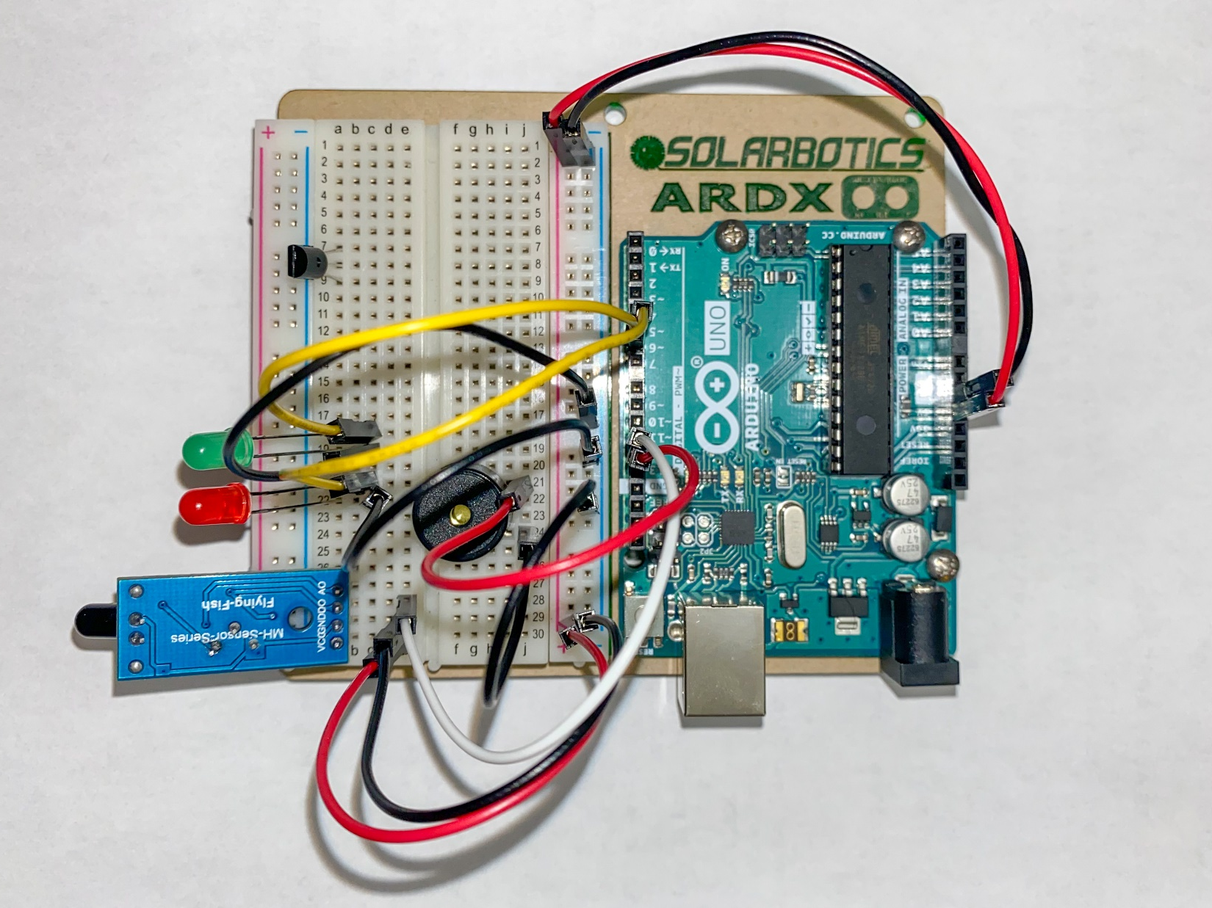
Step 5
Now transistor act as switch

Slide 20
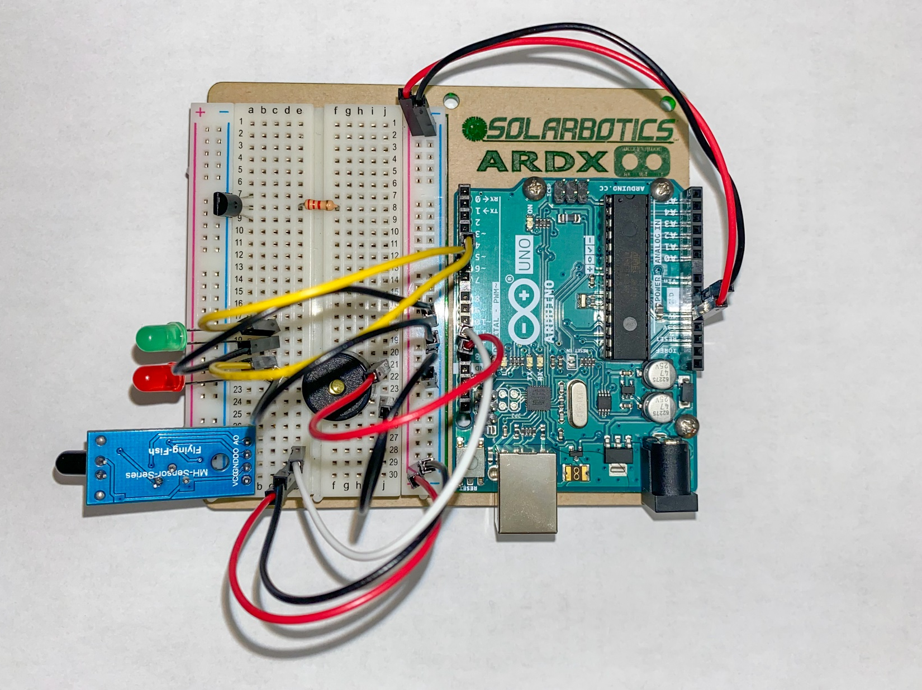
Step 6
Now transister act as switch and resister is connected with base of transister

Slide 21
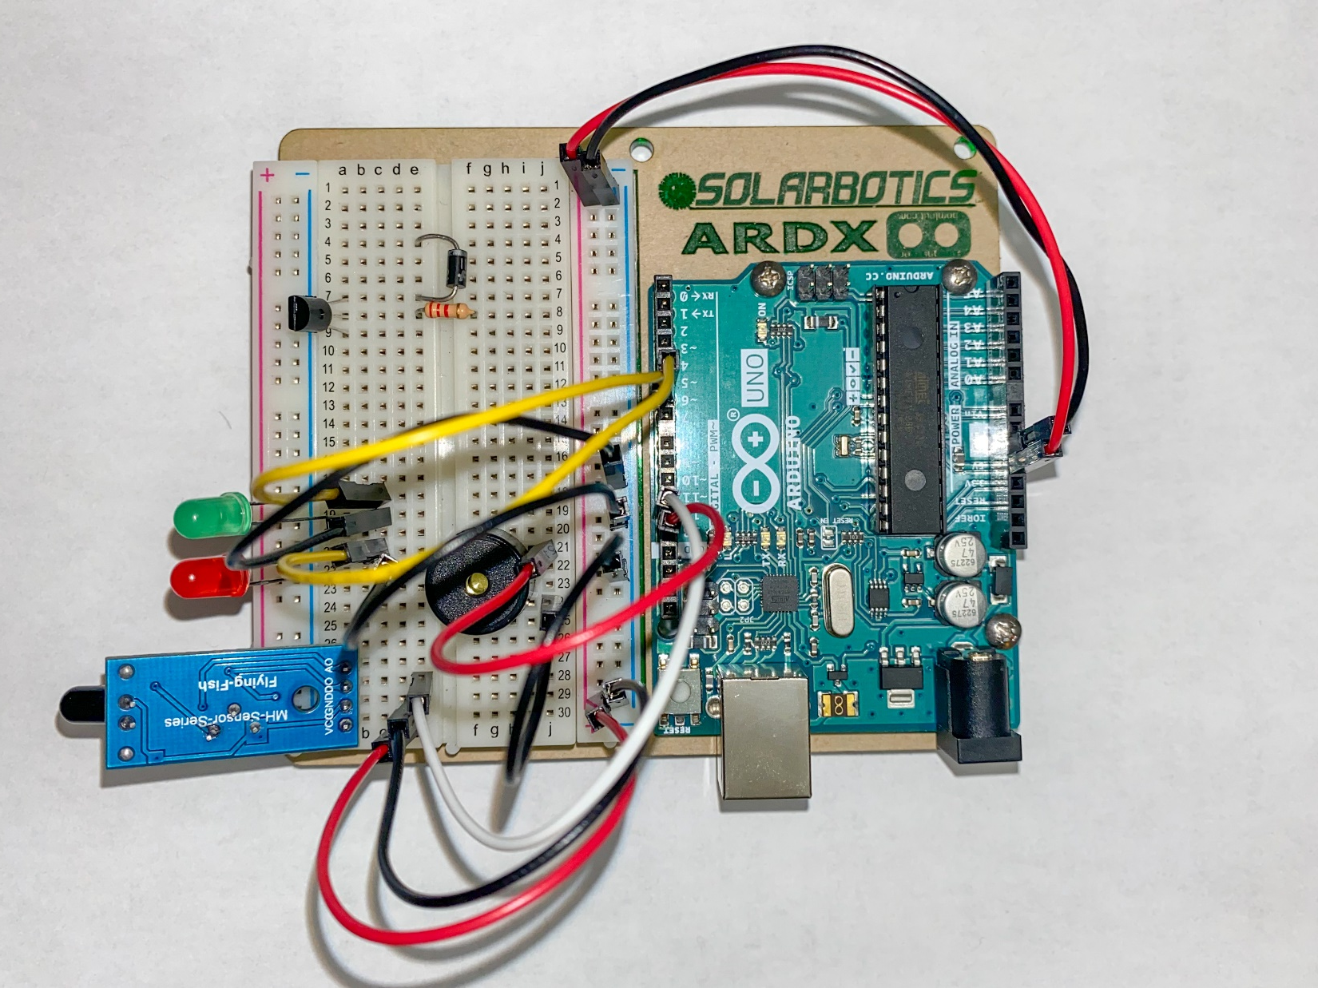
Step 7
Now transister act as switch and resister is connected with base of transister
Diode is connected to one end of transister

Slide 22
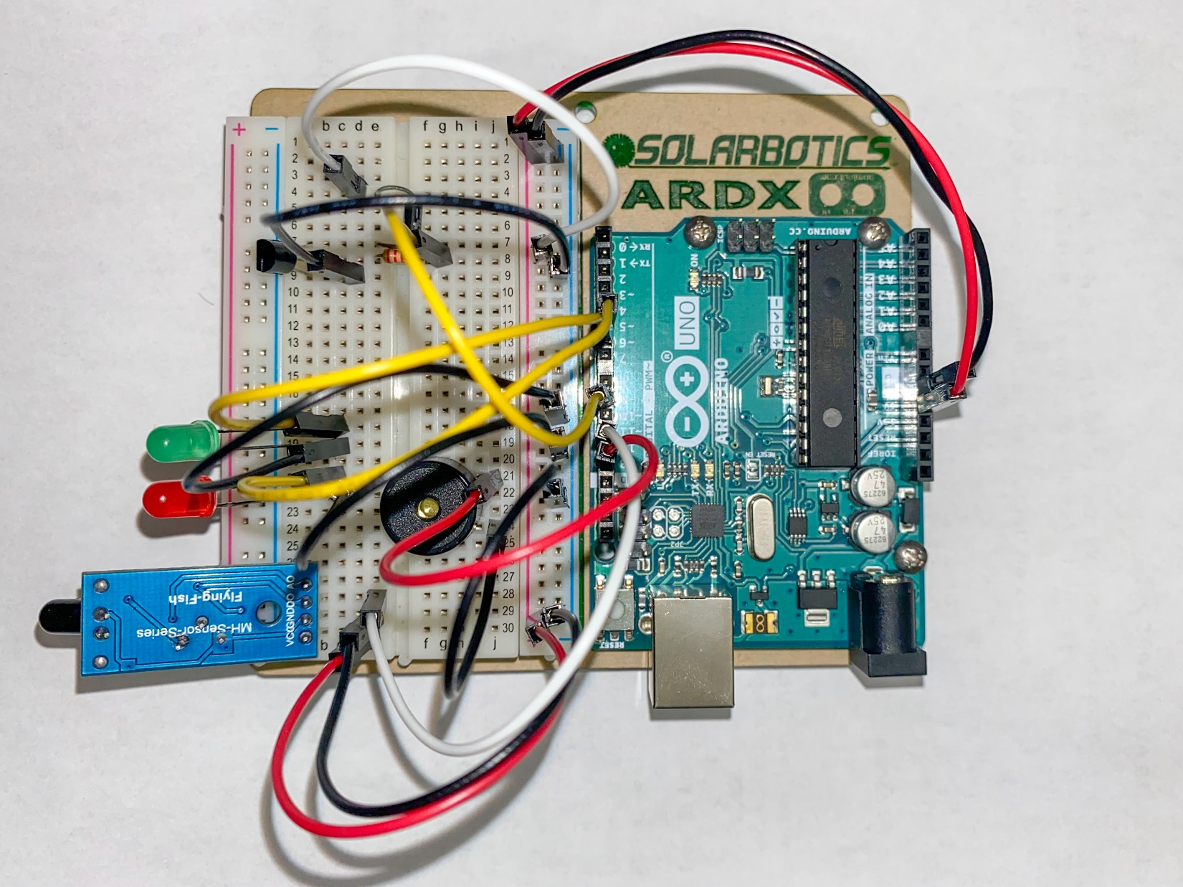
Step 8
The end of resister of connected to pin 9 and the (+) diode is with ground
And the one remaining end is with + 5 volts

Slide 23
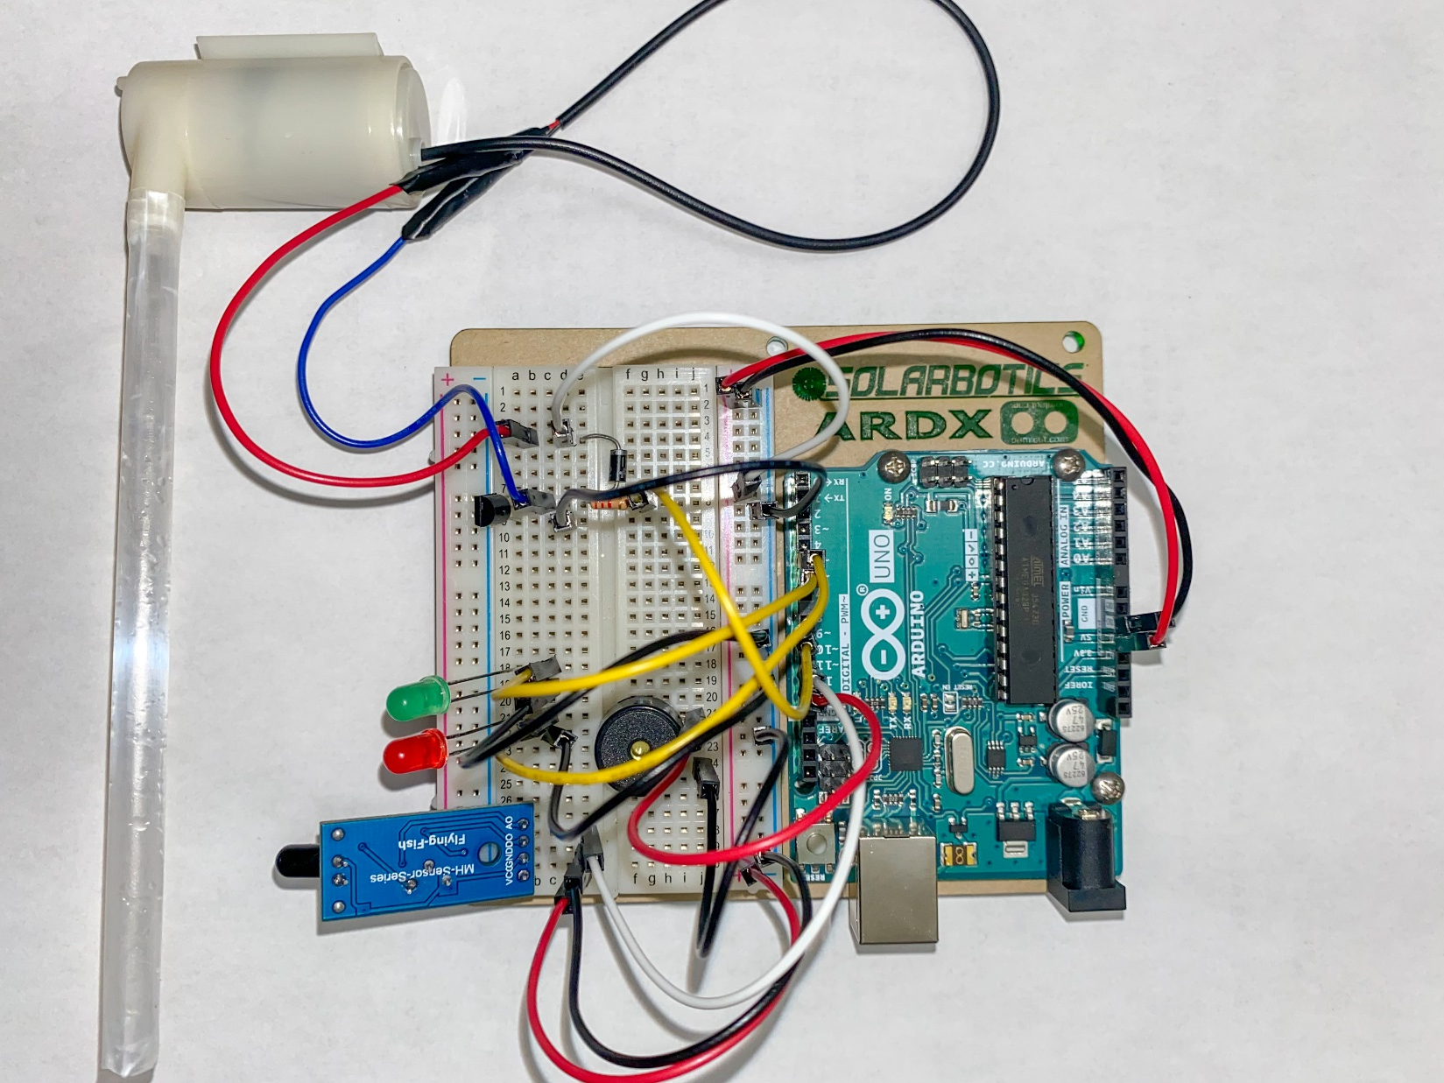
Step 9
Mini submersible pump is connected in parallel connection to diode

Slide 24
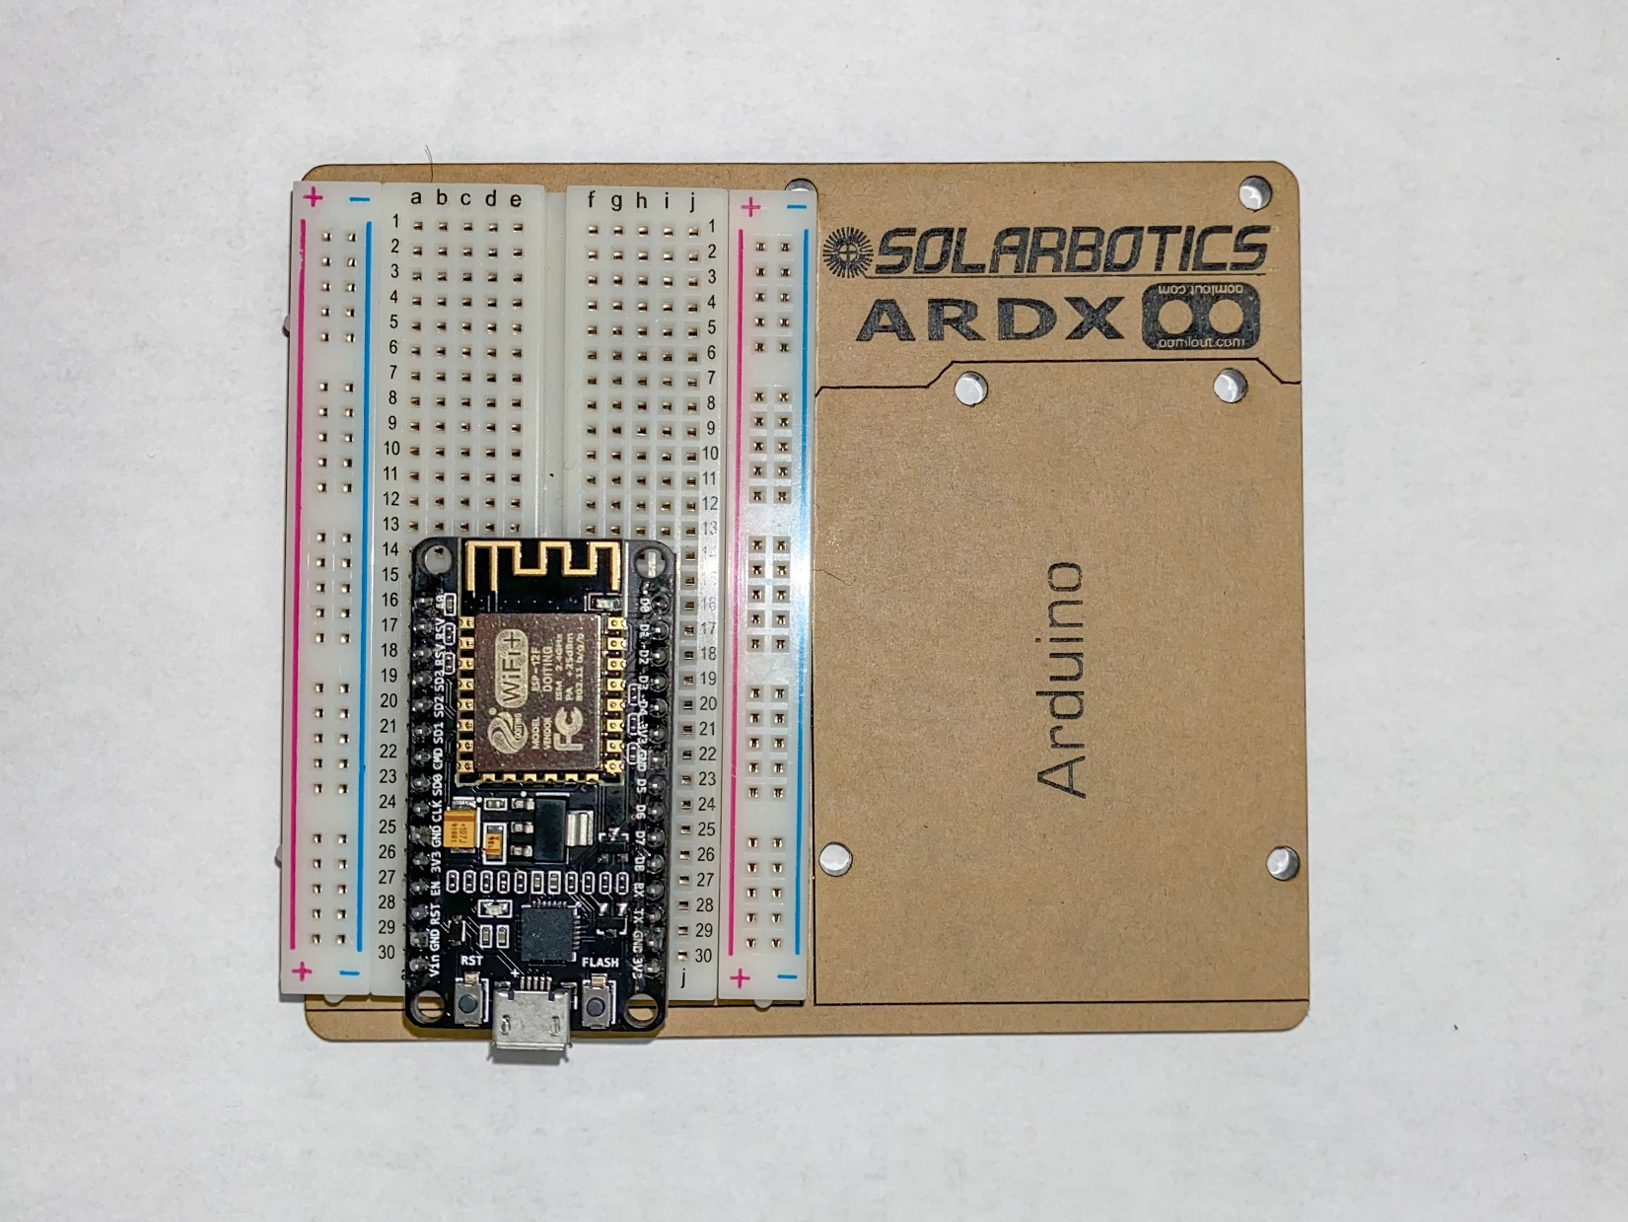
Step 10
Coming to connection of Wi-Fi module

Slide 25
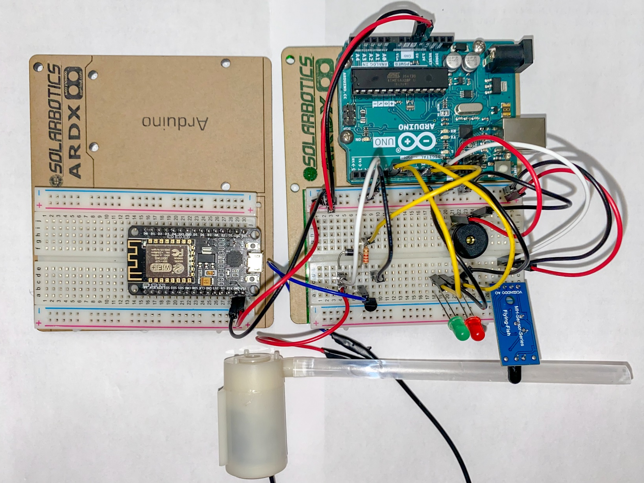
Step 11
Coming to connection of Wi-Fi module
VIN is connected with +5 volts
GND is with ground

Slide 26
Step 12
Coming to connection of Wi-Fi module
VIN is connected with +5 volts
GND is with ground
D0 pin of flame sensor is connected to D0 pin of Wi-Fi module

Slide 27
Ready for Code ?
HERE WE GO….

Slide 28
Thank you

